Slide 1
Success Case(s) & Future Agendas on Implementation of IWRM in each Country
Title
Country
Organization
Current Situation and Problem of Water Related Facilities
Countermeasure
Impact of the Countermeasure
Key for Success
Future Agenda
*It is highly recommended to explain in detail, such as the target water supply system which some issues are occurring and the countermeasures to solve them.
*Please note that the good case studies may be introduced in the new IWRM guideline for practitioners on river basin management as a model example.

Slide 2
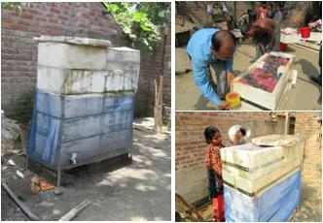
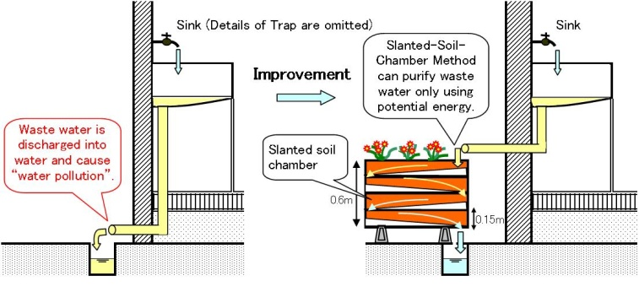
Example
Success Case(s) & Future Agendas on Implementation of IWRM in each Country
Title | Countermeasure against lack of wastewater treatment
Country | --------------------------
Organization | --------------------------
Current Situation and Problem of Water Related Facilities | -------------------------- -------------------------- -------------------------- --------------------------
Countermeasure | The Slanted-Soil-Chamber Method (SSCM) is the decentralized water purification technology and was originally developed to purify the wastewater. After long time field experimentation in Japan, it has been experienced to purify (1) organic matters in Nepal and Vietnam and (2) metal matters like arsenic etc. in Bangladesh. This is the extraordinary method to purify the water with cheapest, easiest and less energy.

Slide 3
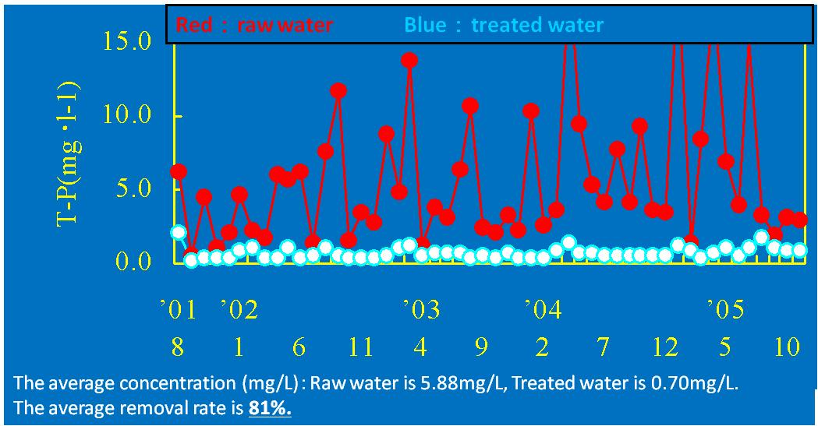
Example
Impact of the Countermeasure | (1) Organic matters in Nepal and Vietnam In case of COD and phosphorous, around 80 % was purified.

Slide 4
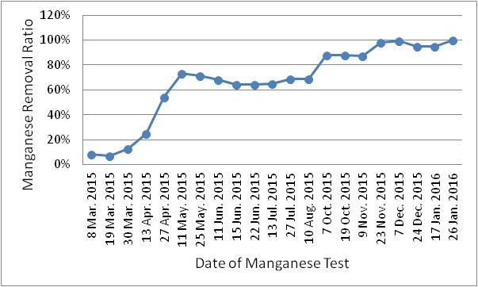
Example
Impact of the Countermeasure | (2) Metal matters in Bangladesh The set of SSCM manufactured and maintained by local NGO and users in the rural area and SSCM removes 100% of iron and manganese and 70% arsenic (cleared the water quality standard in Bangladesh in this case).
Key for Success | Low cost and easy method for water purification (Experienced countries: Vietnam, Nepal, Bangladesh, Japan)
Future Agenda | -------------------------- --------------------------

